Slide 1
BC2407
Analytics ll
Seminar Group 3 Team 3
Ananya Balehithlu (U2021741A)
Charlynn Chia (U2010628D)
Chua Jing Wen Rachel (U2021383J)
Gao Yiping (U2022132D)
Yeo Galvin (U2010712B)

Slide 2
Table of Contents
01
02
03
04
Business Problem
Data cleaning & exploration
Data preparation & cleaning
Data Visualization and insights
Predictive Modelling Techniques
Logistic regression
Neural Network
Random Forest
Final Model
Tableau Live Demonstration
Conclusion
Recommendation
Ananya Balehithlu

Slide 3
Business Problem
Ananya Balehithlu

Slide 4

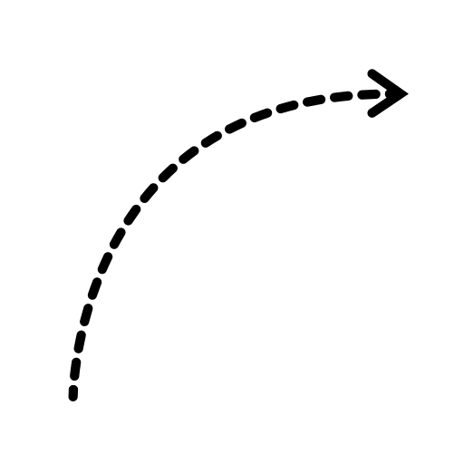



Business Problem
Increasing trend of insurance fraud
3x
2018
2022
20% of all motor insurance claims are fraudulent.
Ananya Balehithlu

Slide 5





Business Problem
Difficult to share client information amongst themselves
Rely on GIA to detect fraudulent claims
Other challenges: unable to determine the accuracy of detecting insurance fraud
Results in: unnecessary costs and revenue loss
Ananya Balehithlu

Slide 6





Business Problem
Need for companies to detect fraudulent claims accurately
Cost of pursuing fraudulent claims are high
Reputational Damage
Inability to prevent fraud
Uncertainty of winning litigation cases
Ananya Balehithlu

Slide 7
How do we overcome these challenges and ensure DAI remains competitive?
This is where we come in.
Ananya Balehithlu

Slide 8






Revolutionize DAI’s fraud detection system
Incorporate advanced machine learning techniques
Effectively identify fraud cases & prevent future fraud claims
Reduce time needed to investigate each case
Reduce reliance on GIA
Precise → reduces human error
Takes into consideration ALL available factors
Ananya Balehithlu

Slide 9


Revolutionize DAI’s fraud detection system
More than 90%
Our solution’s incorporation is crucial for DAI’s competitiveness in the long run as they aim to expand and grow as a company.
Ananya Balehithlu

Slide 10
Project Limitations
Ananya Balehithlu

Slide 11
Project Limitations
Data Documentation
Lack of Information
Lack of Relatable Data Source
Limited Understanding of Data, Variables Defined By Assumptions
Lack of False-Positive Costs, Local Detection Rates etc. - Readily Available UK Information Used As Benchmark
Data Source Based in the US - Not 100% Transferable for DAI Singapore
Ananya Balehithlu

Slide 12

Data Exploration
Gao Yiping
Notes:
Thank you Ananya, now I’ll bring you through our Data Exploration process and share with you the insights that we found from the dataset named “Vehicle Insurance Claim Fraud Detection”

Slide 13
Vehicle Insurance Claim Fraud Dataset
1996 -> 1998
FraudFound_P = 0 | Claim is not fraudulent
FraudFound_P = 1 | Claim is fraudulent
Gao Yiping
Notes:
The data in this dataset is collected over 3 years from 1996 to 1998. Since our aim is to predict fraudulent insurance claims for DAI, the target variable “FraudFound_P” in this dataset is the variable that we want to predict as it reflects whether a claims is fraudulent or not. It is a binary variable, meaning that it can only take on the value 0 or 1, where 0 means that the claim application is found to be not fraudulent while 1 means that the claim is fraudulent. With this dataset, we aim to develop a predictive model that could accurately predict the outcome for this variable with precise accuracy.

Slide 14


Data Source
Reliable & Accurate
Gao Yiping
Notes:
The dataset we have chosen was extracted from Kaggle. After further research, we found that the Kaggle user retrieved this dataset from Oracle’s database, which is also a credible and trusted platform, so the dataset is assumed to be reliable and accurate. However, data cleaning is still needed to pre-process the data for use by the predictive models.

Slide 15
Data Cleaning
No Missing values and Duplicate rows of data
Removing Irrelevant Variables
‘PolicyNumber’ is an identification variable and is independent
‘Base Policy’ + ‘Vehicle Category’ -> ‘PolicyType’
Gao Yiping
Notes:
And so I will further elaborate on this process. After exploring the data, we found that the dataset has no missing values or duplicate values. We also found that the variable “PolicyNumber” is an identification variable and is independent of each claim application. Moreover, “PolicyType” is a variable that is based on the values in the other 2 variables “Base Policy” and “Vehicle Category”.
Since these 2 variables provides no meaningful contribution to our analysis, we will remove them from our dataset.

Slide 16
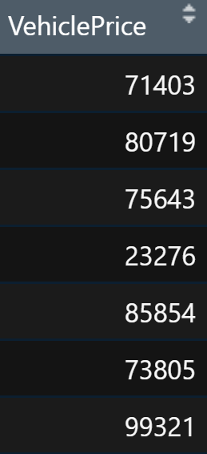
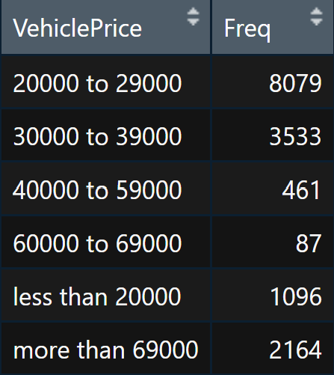
Data Cleaning
Gao Yiping
Notes:
There are some variables in the dataset that contains many levels that represents numerical ranges. Take the variable “VehiclePrice” here as an example. These ranges do not provide much information that is useful to our predictive models and it also makes developing the model more complex. As such, within these ranges we have generated random numbers respective to their ranges for each data point in the dataset. So after performing data cleaning, we can ensure that the datasets are consistent, accurate and are of optimal quality to be used in data processing for predictive modelling.

Slide 17
Data Visualization
Gao Yiping
Notes:
Next, our team performed Data Visualization to gain a deeper understanding of the dataset and discover the correlation, trend & distributions amongst key variables and from which we can gain insights and make sense of the data.

Slide 18
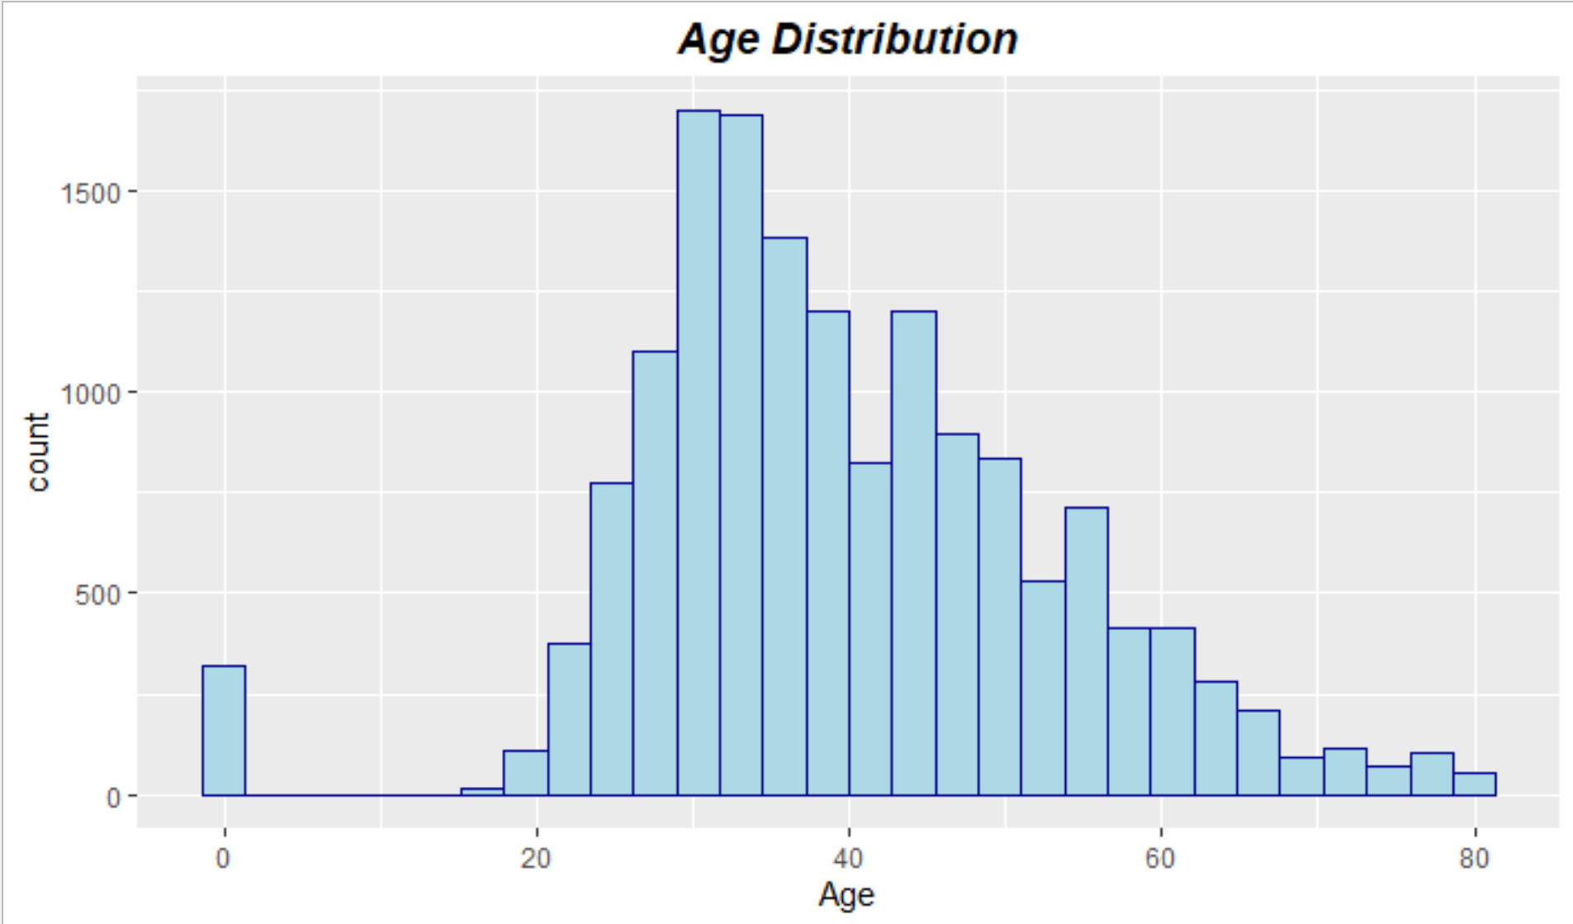
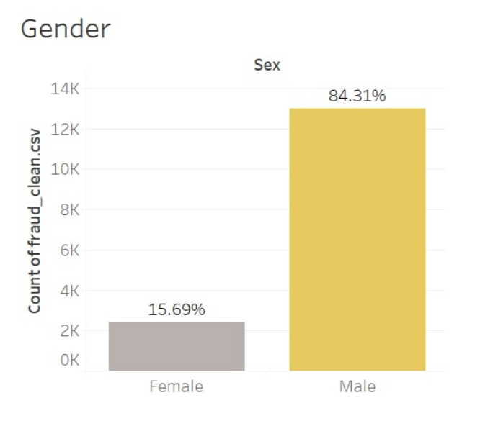
Demographics
Gao Yiping
Notes:
We first visualized some demographic variables such as age and gender. From the left figure, you can see that there is a higher number of individuals who are between 26 and 35 years old who made insurance claims. However, you can see that there are a number of people whose age is recorded as 0. We will assume that these their true age are not recorded for certain reasons. Since we are not sure if this absence may be a determining factor in whether the claim is fraudulent or not, we did not clean and replace these values. Next in the right figure, we can see that a high proportion of people are males compared to females, which does accurately represent the actual composition of people who make vehicle insurance claims. (add animation)

Slide 19
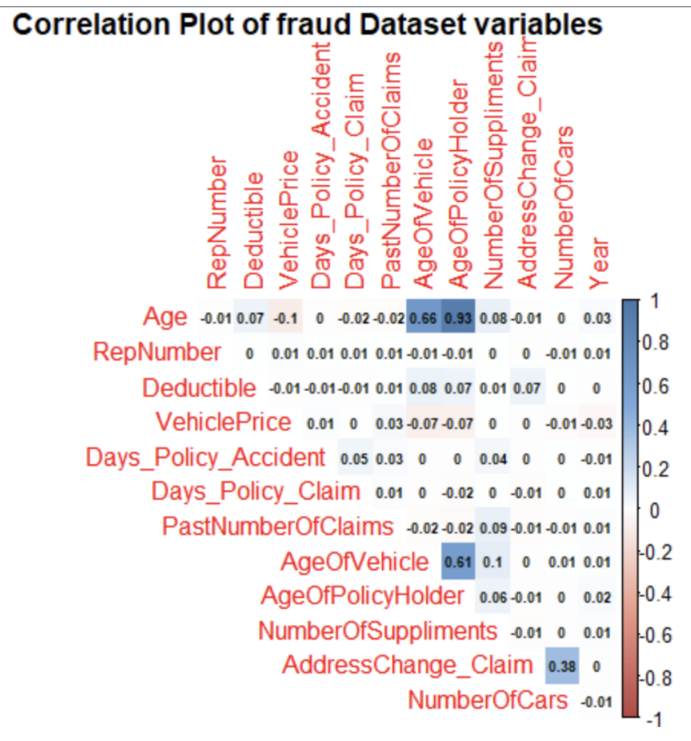
Correlation Plot for Continuous Variables
Gao Yiping
Notes:
We also plotted the correlation between continuous variables in the dataset and we can observe that most of the variables have a weak correlation with one another

Slide 20
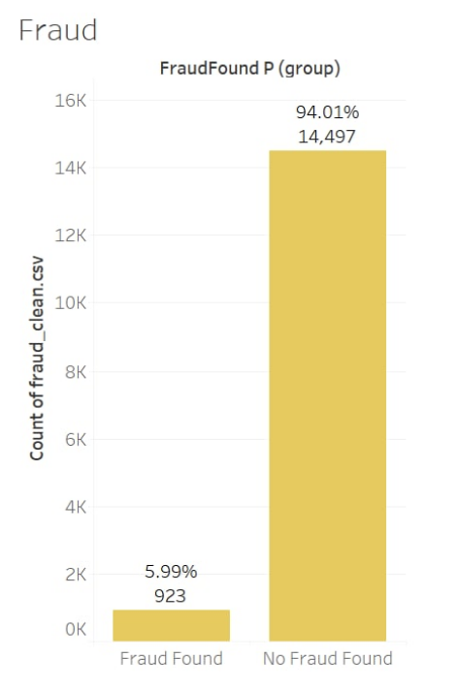
Unbalanced dataset
Solution?
Gao Yiping
Notes:
Most importantly, we visualized the predictor variable “FraudFround_P” to see its proportion. From the bar graph, you can see that the data is highly imbalanced, with a high proportion of around 94% of the data with the outcome that the claim is not fraudulent. The implication of this is that since the model is trained with many data points of no fraud found, the model will be very good at predicting claims that are not fraudulent. However, with the small number of data points for Fraud Found, the model will not be able to predict actual fraudulent claims very well. To resolve this issue, we need to find ways to balance the dataset.

Slide 21
Data Balancing
Gao Yiping
Notes:
I will now bring you through our 3 proposed methods of balancing the dataset

Slide 22
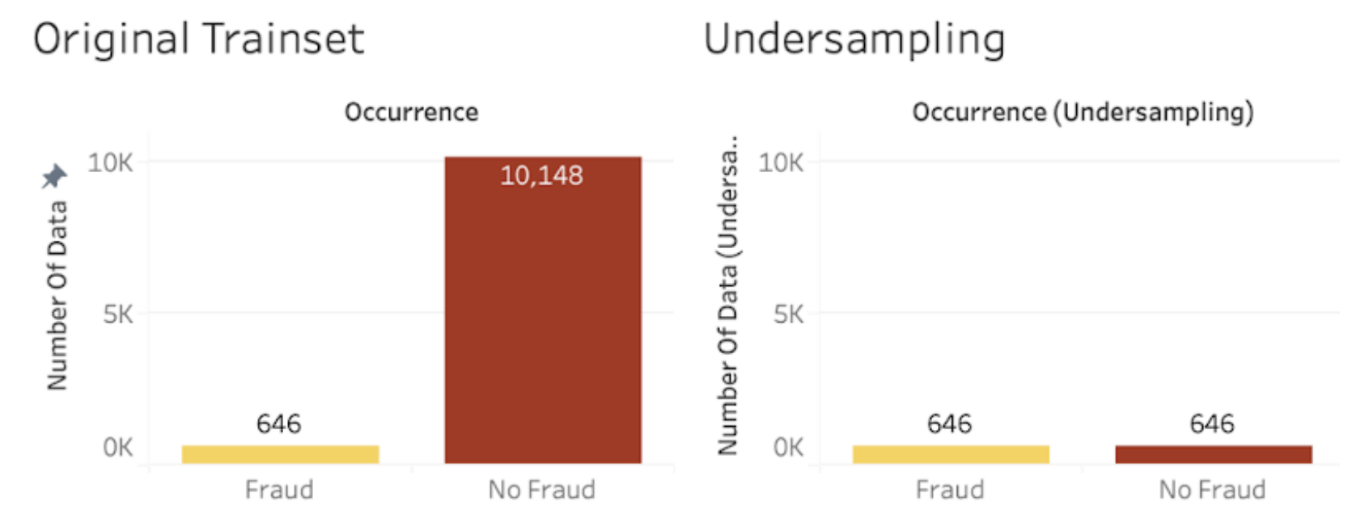
Undersampling
Gao Yiping
Notes:
First, we have Undersampling where we remove additional rows of the majority data to match the minority. However, the issue with this technique is that the removal of data results in a lack of data, which could make the model miss out on important information when it is being built.

Slide 23
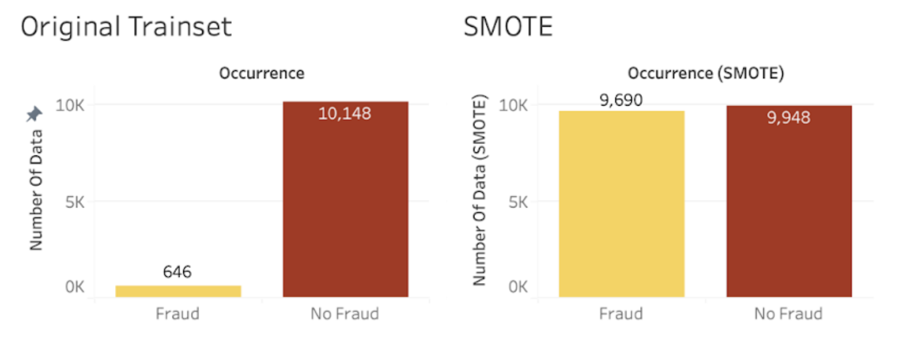
2. Hybrid Sampling and Oversampling
Gao Yiping
Notes:
Next we have a Hybrid of undersampling and oversampling to under sample the majority slightly and oversample the minority.

Slide 24
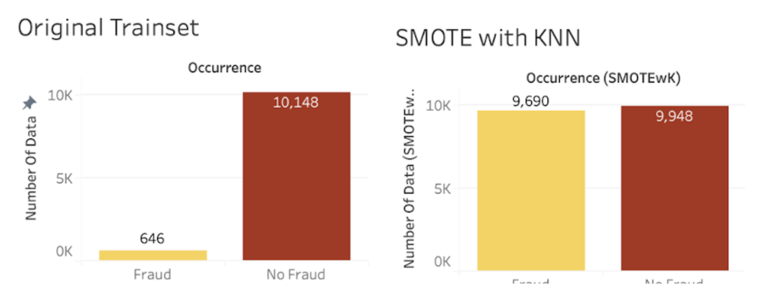
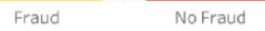
3. Hybrid Undersampling and Oversampling with K-Nearest Neighbour Algorithm
Gao Yiping
Notes:
Lastly we used the same hybrid approach in method 2 but here we oversample the data using The K-nearest neighbour (KNN) algorithm, where data points close to each other are assumed to be similar and thus the synthetic data can be derived from it. You can see that after applying each of the 3 methods on the data, the train data is more balanced.I will now hand over my time to rachel.

Slide 25
Predictive Modeling Technique
Logistic Regression
Neural Network
Random Forest
Final Model
Chua Jing Wen Rachel
Notes:
We will be presenting on…

Slide 26
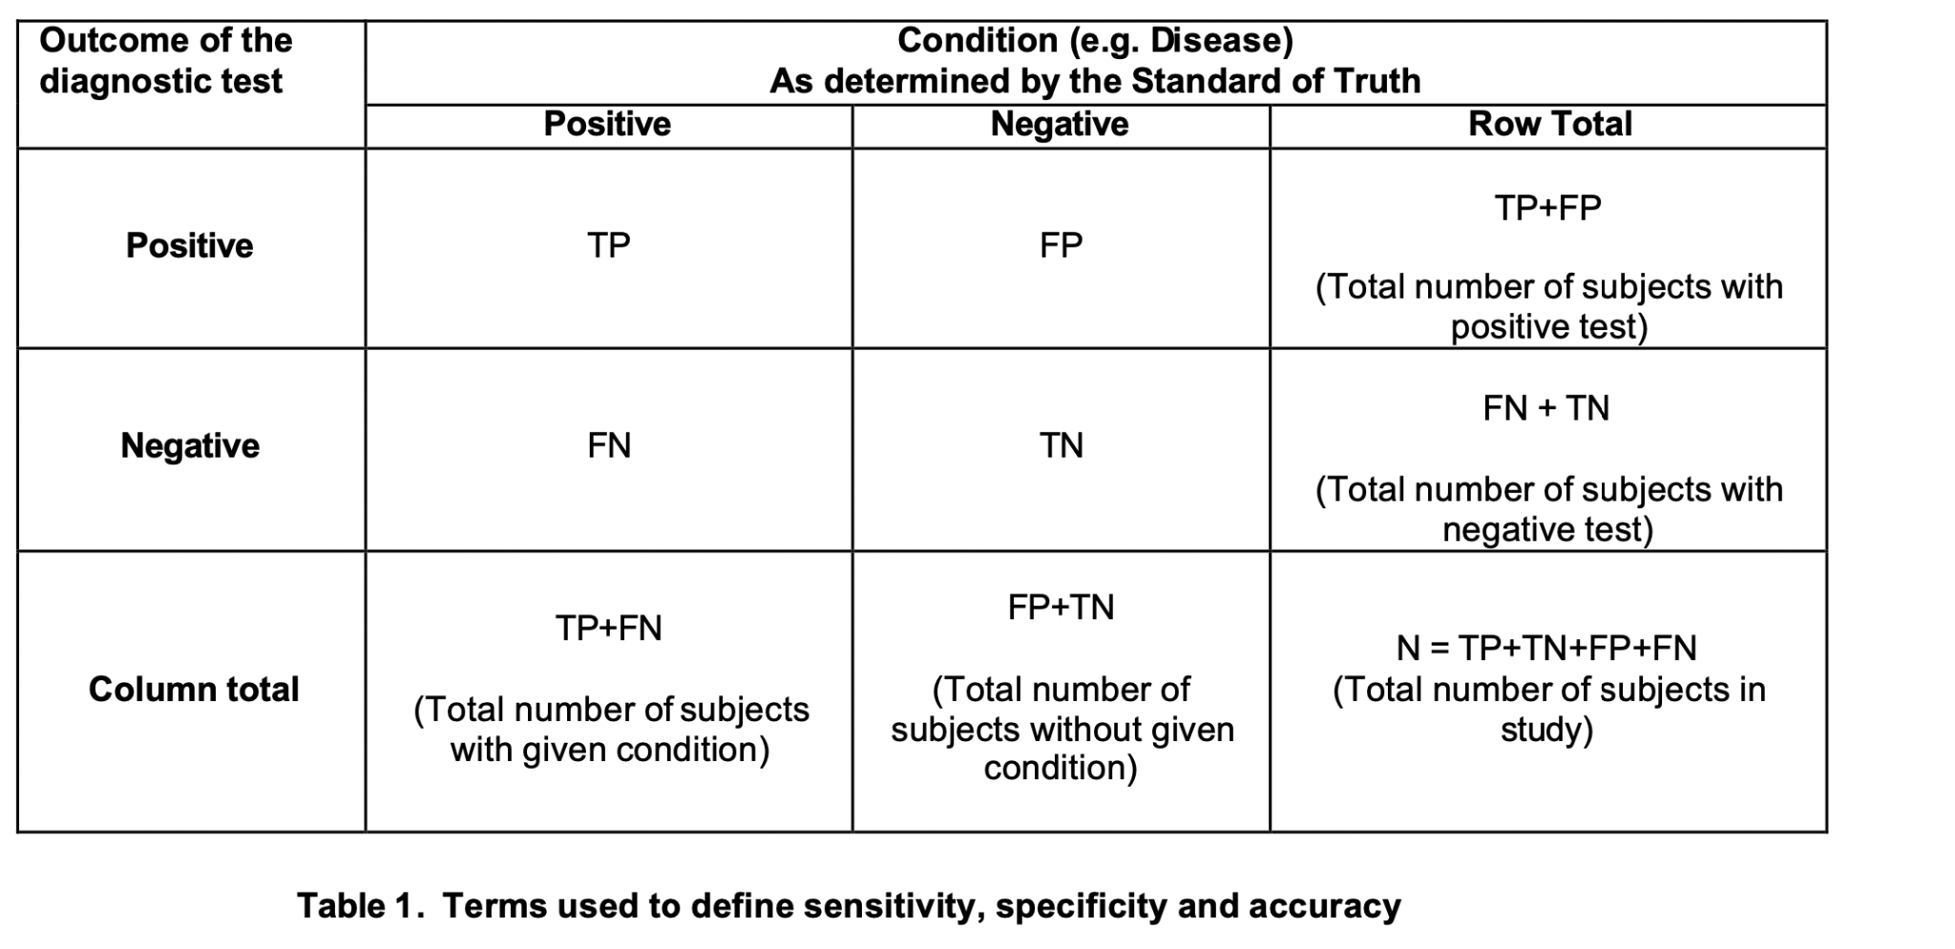
Model Evaluation Criteria
Chua Jing Wen Rachel
Notes:
We use true negative, true positive, false negative and false positive to calculate sensitivity, accuracy and specificity which are our model evaluation criteria. Here is the table of how to calculate them base on the outcome of the test.
As suggested by above equations, sensitivity is the proportion of true positives that are correctly identified by a diagnostic test. It shows how good the test is at detecting a fraud
Accuracy is the proportion of true results, either true positive or true negative, in a population. It measures the degree of veracity of a diagnostic test on a condition.
Specificity is the proportion of the true negatives correctly identified by a diagnostic test. It suggests how good the test is at identifying normal (negative) condition.
For DAI, sensitivity would be a significant metric while considering the suitable accuracy and specificity level. Due to the low current detection rate for actual fraud occurrences, low sensitivity would be more costly as compared to false positives in order for DAI to reduce overall costs in fraud investigation. However, specificity and accuracy will still be considered as the machine learning model should not produce too many false-positives resulting in unnecessary and fruitless fraud investigations.
https://www.lexjansen.com/nesug/nesug10/hl/hl07.pdf

Slide 27
Model Evaluation Criteria
Sensitivity
Accuracy
Specificity
True Positive
True Positive + True Negative
True Negative
True Positive + False Negative
True Positive + True Negative + False Negative + False Positive
True Negative + False Positive
Chua Jing Wen Rachel
Notes:
As suggested by above equations, sensitivity is the proportion of true positives that are correctly identified by a diagnostic test. It shows how good the test is at detecting a fraud
Accuracy is the proportion of true results, either true positive or true negative, in a population. It measures the degree of veracity of a diagnostic test on a condition.
Specificity is the proportion of the true negatives correctly identified by a diagnostic test. It suggests how good the test is at identifying normal (negative) condition.
For DAI, sensitivity would be a significant metric while considering the suitable accuracy and specificity level. Due to the low current detection rate for actual fraud occurrences, low sensitivity would be more costly as compared to false positives in order for DAI to reduce overall costs in fraud investigation. However, specificity and accuracy will still be considered as the machine learning model should not produce too many false-positives resulting in unnecessary and fruitless fraud investigations.
https://www.lexjansen.com/nesug/nesug10/hl/hl07.pdf

Slide 28
01
Logistic Regression
Chua Jing Wen Rachel

Slide 29
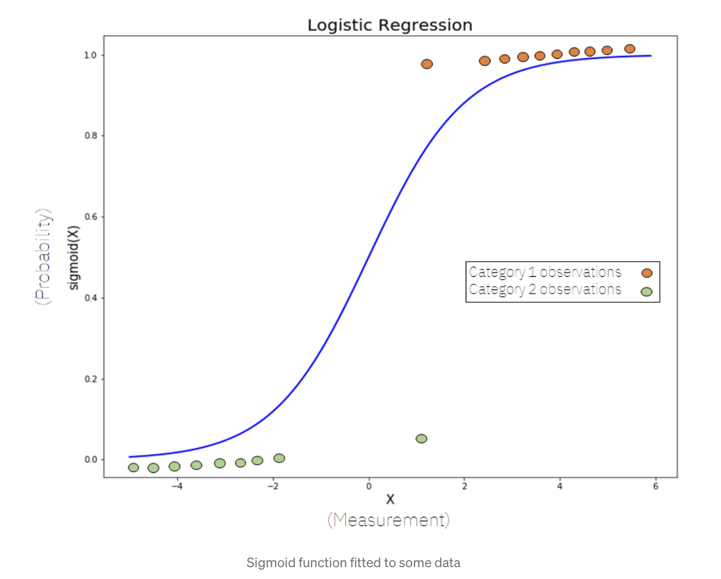
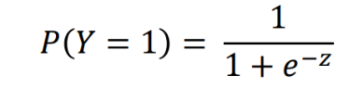
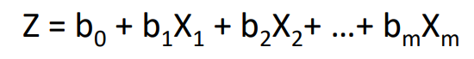
Introduction to logistic regression
The logistic regression model predicts the categorical variable Y based on the logistic formula:
Where b₀ is the intercept and b_{n} is the coefficient for variable x_{n}.
Chua Jing Wen Rachel
Notes:
Logistic regression uses the historical pattern of other variables from the training data set to attempt to predict the probability of an occurrence being a fraud (FraudFound_P = 1).
Logistic regression shows how we derive the result which is why we choose it as one of our model

Slide 30
Binary Prediction (Fraud_found<= 0.5, Fraud_found> 0.5)
Model | Trainset Specificity | Testset Accuracy | Testset Sensitivity
Undersampling | 0.60 | 0.62 | 0.88
SMOTE with KNN | 0.65 | 0.66 | 0.79
SMOTE | 0.71 | 0.71 | 0.66
Chua Jing Wen Rachel

Slide 31
Limitations
Linearity
Overfitting
Inaccuracy
It assumes a linear and relationship between the variables and the predicted values
Tend to overfit the data, particularly in high-dimensional settings
In large datas and as compared to other techniques, logistic regression is usually not accurate.
Chua Jing Wen Rachel

Slide 32
02
Neural Network
Chua Jing Wen Rachel

Slide 33
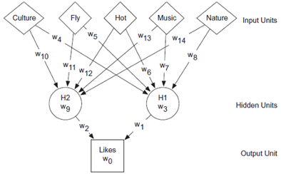
Introduction to neural network
Chua Jing Wen Rachel
Notes:
Neural Network mimics a human nervous system, which is made up of interconnected neurons(nodes). In other words, it is made up of interconnected information processing units.
The neural network draws from the parallel processing of information, which is the strength of this method.

Slide 34
Full Model vs Hybrid Model
Full Model
Hybrid Model
Variables are selected based on our logistic regression model
All variables in the dataset are included
Chua Jing Wen Rachel

Slide 35
Binary Prediction (Fraud_found<= 0.5, Fraud_found> 0.5)
Model | Trainset Accuracy | Trainset Sensitivity | Testset Accuracy | Testset Sensitivity
Full Model | 1.00 | 1.00 | 0.64 | 0.62
Hybrid Model | 0.79 | 0.64 | 0.63 | 0.87
Chua Jing Wen Rachel

Slide 36
Limitations
Fluctuating Model accuracy
Blackbox
Time Consuming
Unexplained functioning of the network: This reduces trust in the network.
Random Initialisation of weights as the starting point
It takes a long time to train neural network model
Chua Jing Wen Rachel
Notes:
Unexplained functioning of the network: This is the most important problem of NN. m The appropriate network structure is achieved through experience and trial and error.
Random Initialisation serves the process of symmetry-breaking and gives much better accuracy . The weights are initialized very close to zero, but randomly
Neural networks are “slow” for many reasons, including load/store latency, shuffling data in and out of the GPU pipeline, the limited width of the pipeline in the GPU (as mapped by the compiler), the unnecessary extra precision in most neural network calculations (lots of tiny numbers that make no difference to the outcome), the sparsity of input data (lots of 0s), and many many other factors.
https://towardsdatascience.com/random-initialization-for-neural-networks-a-thing-of-the-past-bfcdd806bf9e

Slide 37
03
Random Forest
Chua Jing Wen Rachel

Slide 38
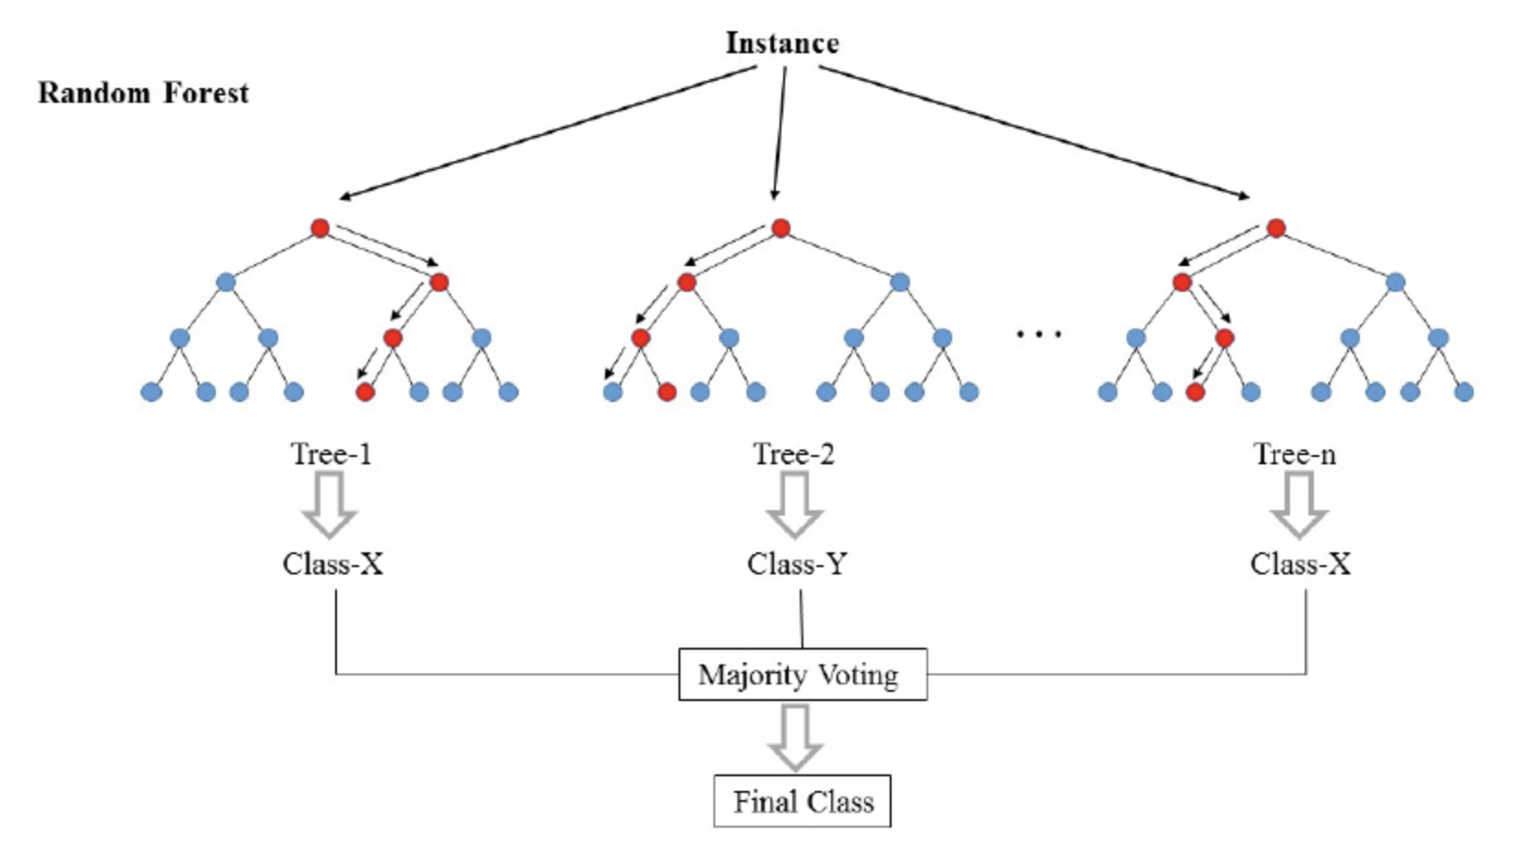
Introduction to Random Forest
Chua Jing Wen Rachel
Notes:
Random Forest is an ensemble learning method. In Random Forest, many decision trees are constructed on various subsets of the dataset. The random forest then takes the prediction from each tree and, based on the majority votes of predictions, predicts the final output.
The advantage of Random Forest is it helps to avoid overfitting of decision trees.
https://www.analyticsvidhya.com/blog/2020/12/lets-open-the-black-box-of-random-forests/

Slide 39
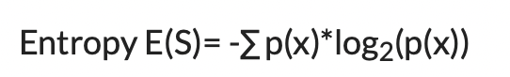
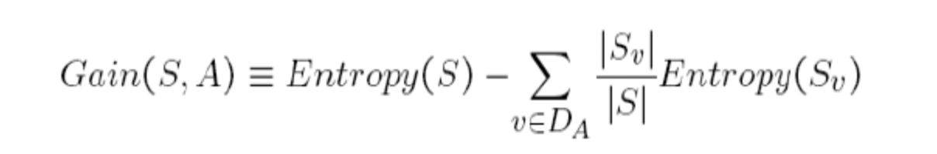
Mathematical concepts behind Decision Tree
Notes:
2 important mathematical concepts behind decision tree of random forest are entropy and information gain.
Entropy is a measure of the randomness of a system. The entropy of sample space S is the expected number of bits needed to encode the class of a randomly drawn member of S.
The information gain is the amount by which the Entropy of the system reduces due to the split that we have done. We have created the tree using observations

Slide 40
Limitations
Only use for predictive models
Time Consuming
Does not show relationships between variable only predicts the outcome
It generates large number of trees which makes the algorithm slow
Chua Jing Wen Rachel
Notes:
The main limitation of random forest is that a large number of trees can make the algorithm too slow and ineffective for real-time predictions. In general, these algorithms are fast to train, but quite slow to create predictions once they are trained. A more accurate prediction requires more trees, which results in a slower model. In most real-world applications, the random forest algorithm is fast enough but there can certainly be situations where run-time performance is important and other approaches would be preferred.
And, of course, random forest is a predictive modeling tool and not a descriptivetool, meaning if you're looking for a description of the relationships in your data, other approaches would be better.

Slide 41
Final Model
Chua Jing Wen Rachel

Slide 42
Model | Accuracy | Sensitivity | Specificity
Logistic Regression | 61.82% | 87.73% | 60.17%
Neural Network | 62.56% | 86.64% | 59.32%
Random Forest | 63.08% | 92.42% | 61.21%
Chua Jing Wen Rachel
Notes:
The random forest model yields the highest sensitivity and specificity which translates to the lowest cost to DAI and would solve their issue of having difficulty detecting insurance fraud occurrences with limited data

Slide 43
Demonstration of Dashboards
Chua Jing Wen Rachel

Slide 44
Dashboard live Demonstration
Chua Jing Wen Rachel

Slide 45
Interactive dashboard for DAI agents
Easy to understand factors that cause fraud and improve policies
Visual live update on insurance claim cases
Chua Jing Wen Rachel
Notes:
Summarized in one page allows easy understanding of dataset for DAI agents who may not gain insights from looking at the raw data.
Visualisation of data allows DAI agents to see the real time changes of insights derived when dataset changes.

Slide 46
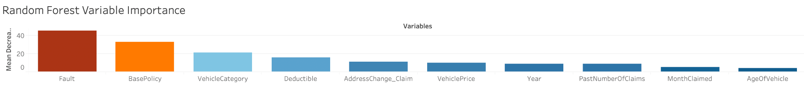
Dashboard Insights
Chua Jing Wen Rachel
Notes:
The variable importance can be looked into, to find more information on how these factors will result in higher probability of fraud. Therefore, improving fraud detection before insurance claim.

Slide 47
Recommendations
Charlynn Chia

Slide 48
Web-Based Application For Prediction
Charlynn Chia

Slide 49
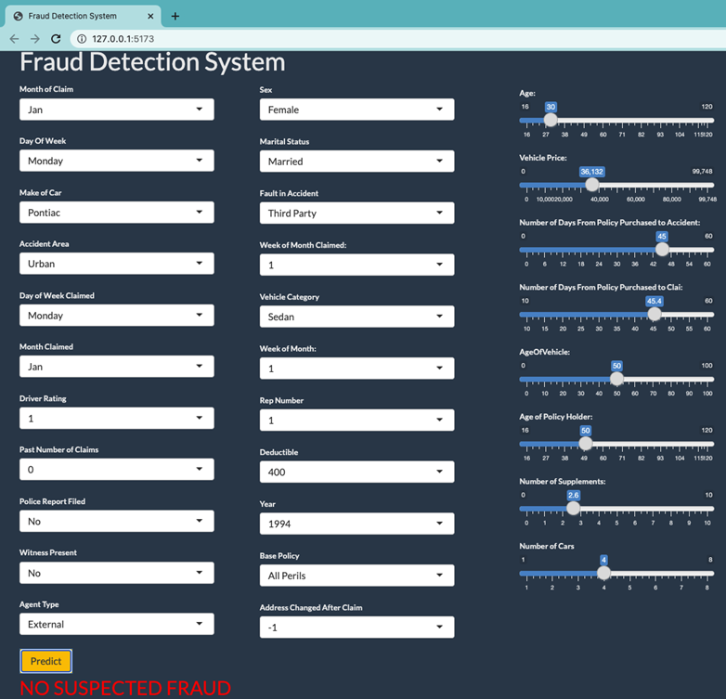
R Shiny Interface
Charlynn Chia

Slide 50
Implementation Process of Graphical Interface using RShiny
Develop a random forest model using DAI’s data
Phase 1
Phase 2
R Shiny Interface
User Friendly Graphical Interface
Investigation of Detected Fraud
Strengthening of Model
Charlynn Chia

Slide 51
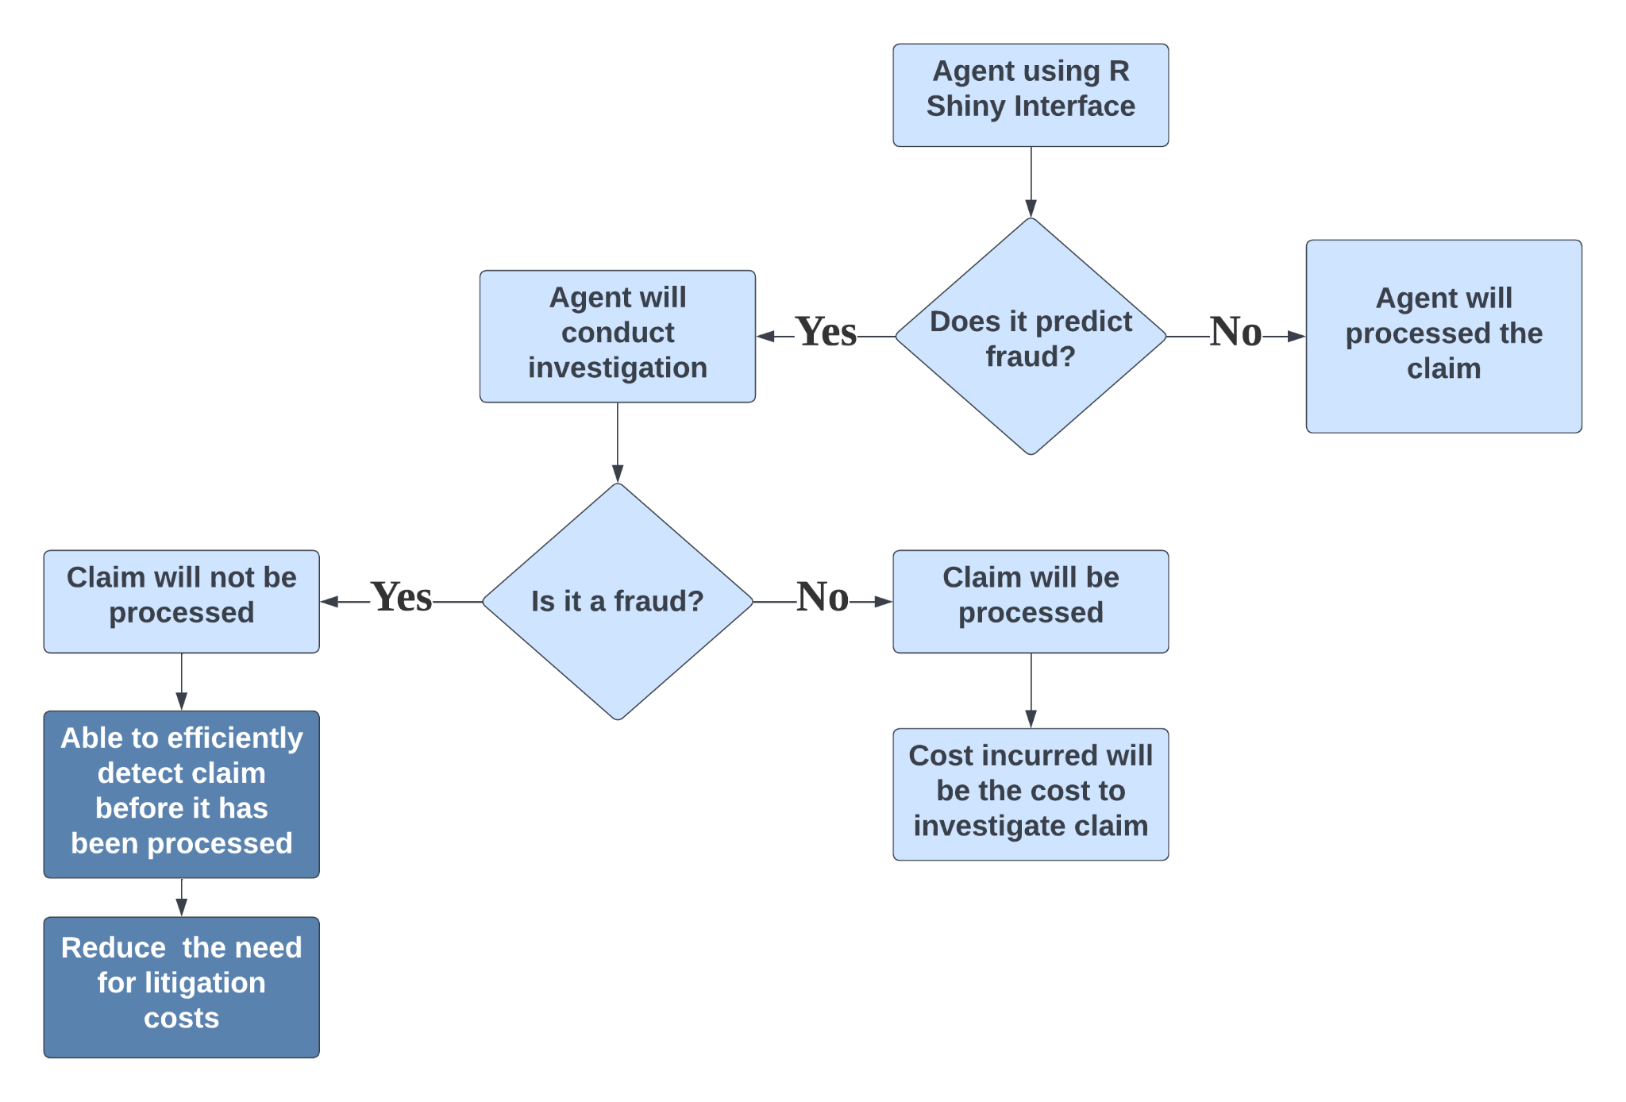
Process of Using the Interface
Charlynn Chia

Slide 52
How it would address the problem?
Time-Efficient
Labour-Efficient
Cost-Efficient
Quickly Input, Obtain Information, Increase Data
Automatic Prediction & Data Collection/Processing to Reduce Labour
Precise Prediction & Information
Charlynn Chia

Slide 53
Considerations
Distrust and Resistance from Agents
Collecting new data to improve model periodically
Charlynn Chia

Slide 54
R Shiny Demonstration
Yeo Galvin

Slide 55
Web-Based Application
Live Demonstration
Yeo Galvin

Slide 56
2. Deterrence & Mitigation With Real-Time Insights
Yeo Galvin

Slide 57
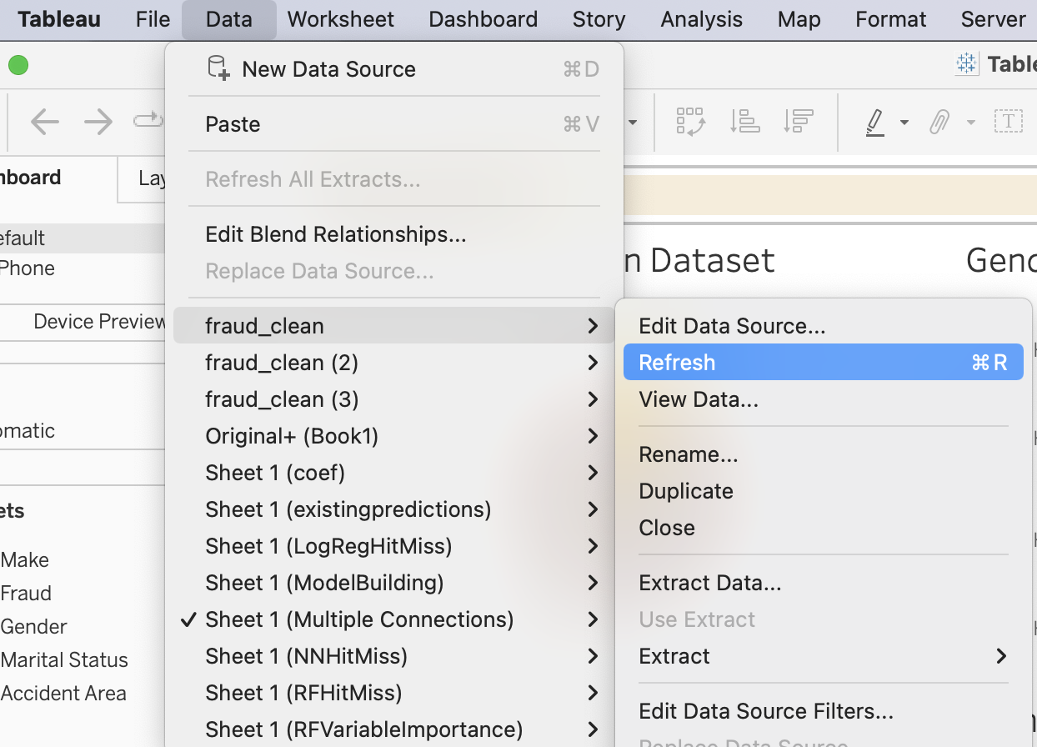
Tableau’s Connection To Data
Control
Real-Time Updates
Insights
Deter
Machine Learning Program ↔ Data ↔ Dashboard
Yeo Galvin

Slide 58
Insights
Policyholders
Claims
Fraudsters
General insights about their customer base
Insights about their claimants’ patterns and dominant factors
Insights on what factors are dominant in fraudulent claims
Yeo Galvin

Slide 59
Deter & Mitigate
Screening
Restrict Fraud Benefit
Clauses
Stringent Policyholder Screening Process
Alter Premiums/Pay-Outs/Coverage for Policies with High Fraud Risk
Include Mitigation Clauses in Identified Potential Fraudsters’ Policies
E.g. Decline Policy Purchase by Customers who fulfill all demographics of fraudsters
E.g. Sports & Policyholder Fault Increases Fraud Risk:
Increase Premiums/Decrease Pay-Out/Coverage & Only Third-Party Fault Claims for Sports Cars
Yeo Galvin

Slide 60
Conclusion
Yeo Galvin

Slide 61
Conclusion
Machine Learning Effective, Efficient, Versatile
Allow DAI to:
Detect Fraud With Precision
Decrease Reliance on GIA
Increased Efficiency
Lower Cost
Significant Benefits to the Fraud Detection Process, DAI and Overall Insurance Industry
Yeo Galvin

Slide 62
Thank You
Yeo Galvin

